Slide 1
Banking Application
Design

Slide 2
Pages
The Landing
Account →Account Opening Form
Card → Card Apply Form
Loan →Loan Apply Form
User Dashboard
Login
Register
About
Contact

Slide 3
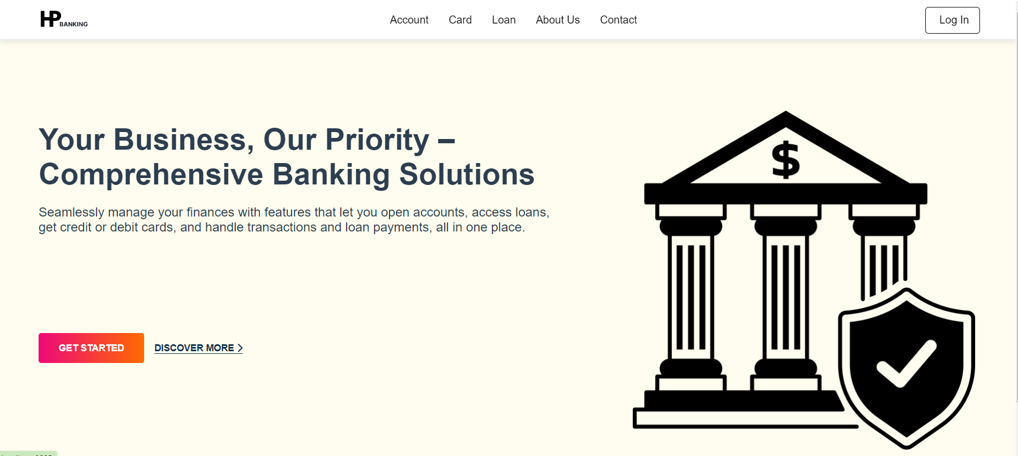
The Landing Page

Slide 4

Account Page
Account
Empower your business. Banking solutions, customized to your needs.
To Know More, click here
Open Account
Features & Benefits of Account
Instant Account Opening: Effortlessly open an account with just a few details. Enjoy the convenience of a seamless and secure account creation process directly integrated with your user profile.
Real-Time Balance and Transaction Alerts: Stay informed with real-time updates on your account balance and transactions, ensuring you are always aware of your financial status and activities.
Integrated Account Services: Easily link and manage your loans, credit/debit cards, and other banking services from a single dashboard, simplifying financial management.

Slide 5

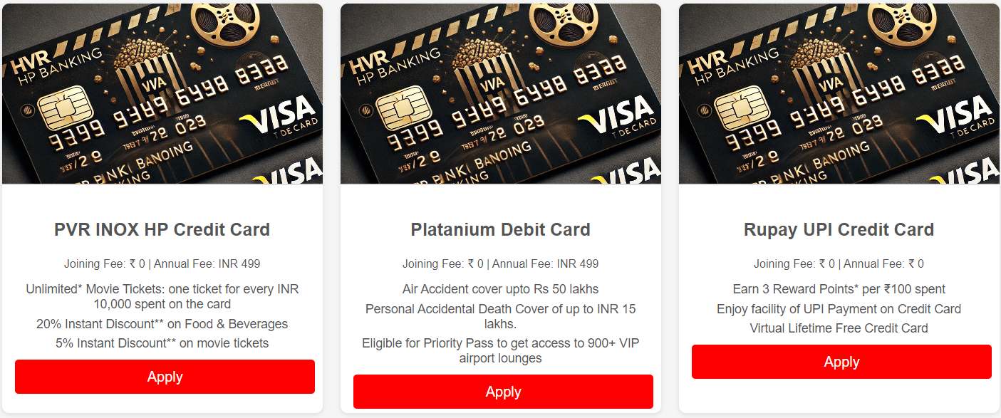
Card Page
Cards
Our Credit & Debit Cards are designed to suit the need of every individual. Whether you're looking for a low fee card or a card that rewards you for everyday spend, we have a Card to match your individual needs.

Slide 6

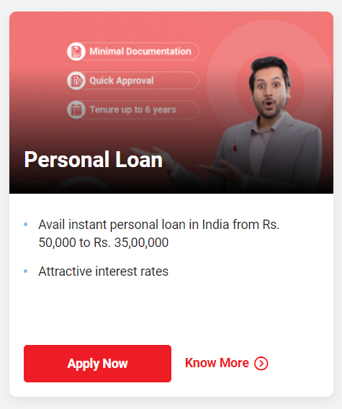
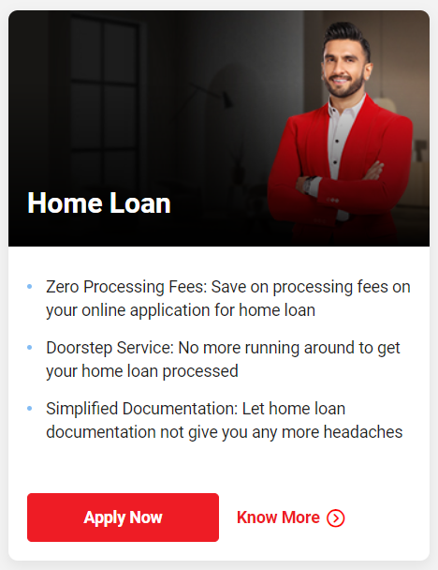
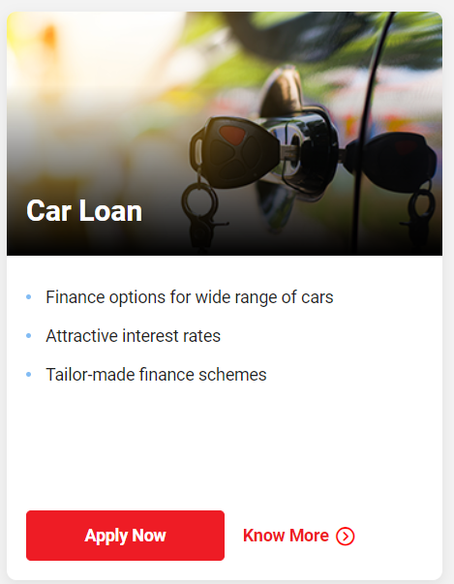
Loan Page
Get an instant Personal loan within 3 seconds
APPLY NOW
Type of Loan
See our full range of loan products and explore based on your requirement

Slide 7
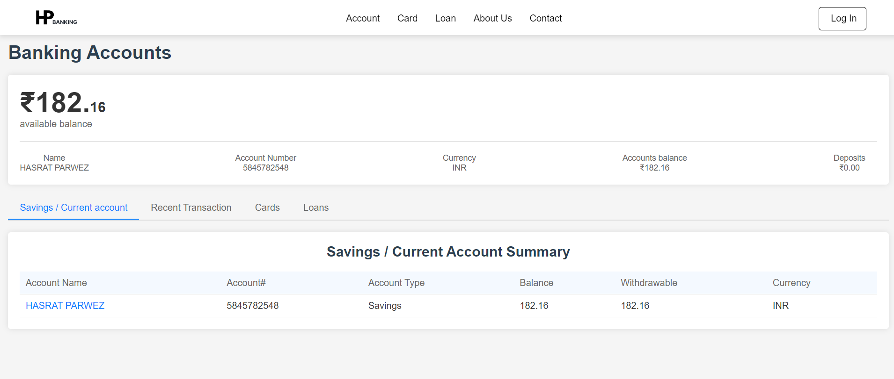
Dashboard Page

Slide 8
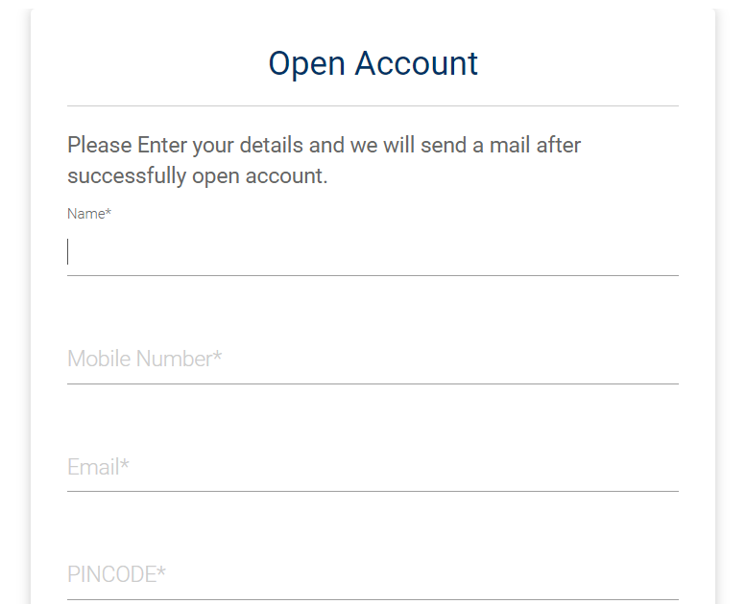
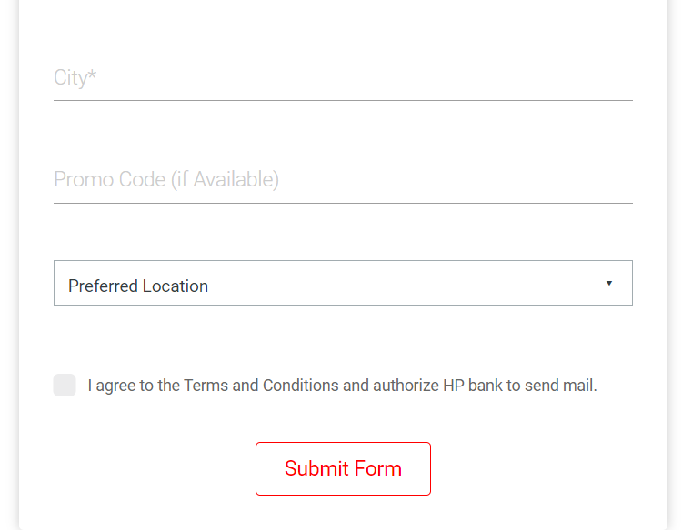
Sample Form Page

